Slide 1
Predicting Physical Activities Using Body Sensor Data
Matthew Goralczyk | MSDS-696

Slide 2
Data Source
MHEALTH Data Set from the UCI ML Repository
https://archive.ics.uci.edu/ml/datasets/MHEALTH+Dataset
Generated by a group of researchers at the University of Granada.
Body sensors attached to participants who then performed a variety of exercises.
Notes:
Exercises: Standing still, sitting and relaxing, lying down, walking, climbing stairs, waist bends forward, frontal elevation of arms, crouching, cycling, jogging, running, jump front and back.

Slide 3
Project Goal
Using R… Explore the data set.
Compare a selection of supervised machine learning methods to see how they perform.
Random Forests, XGBoost, and SVM
Conclude by reflecting on which supervised method was best overall.
Prediction performance
Ease of use
Intuition

Slide 4
Preparation and Sampling
Data was sourced from 10 participants.
Had to merge the participant data logs.
Merged data was fairly large, over 300k rows.
Had to take a stratified sample.
Package: splitstackshape, stratified() function
Prepared training and test sets.
12k rows each.

Slide 5
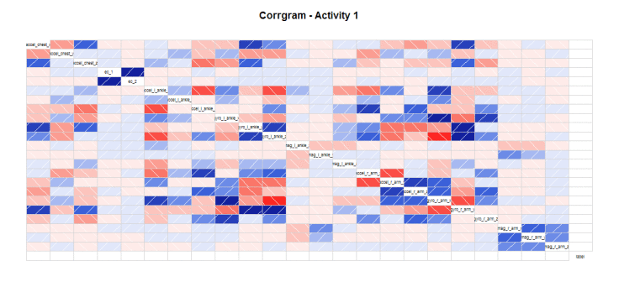
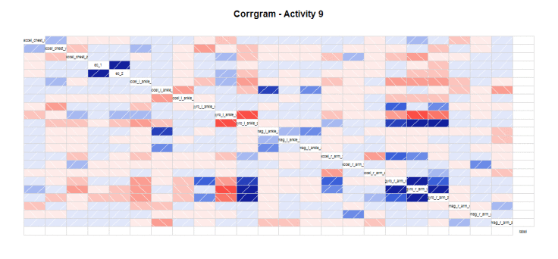
Exploration - Correlograms
Correlograms by activity.
Each activity shows its own unique correlation patterns.
Example: Cycling will see a lot correlation with ankle sensors.

Slide 6
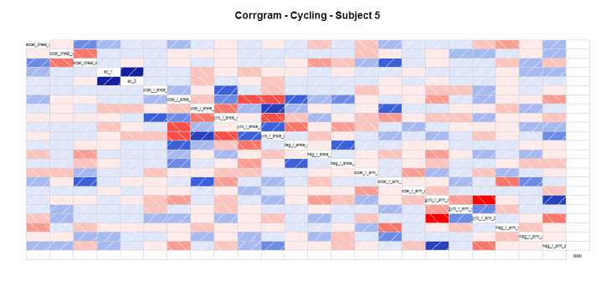
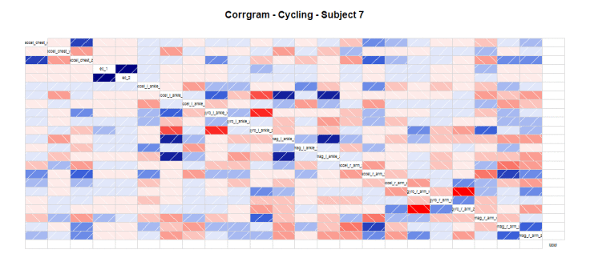
Exploration - Correlograms
Correlograms by subject.
Each subject performs a physical activity in their own unique way.
Across exercises we’ll see similar patterns but with some variance amongst participants.
Researchers selected a diverse set of participants.

Slide 7
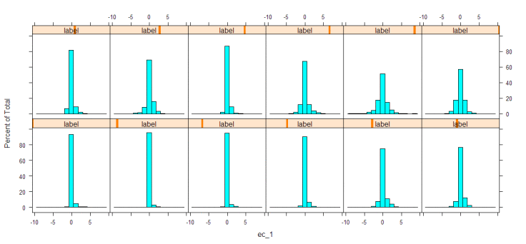
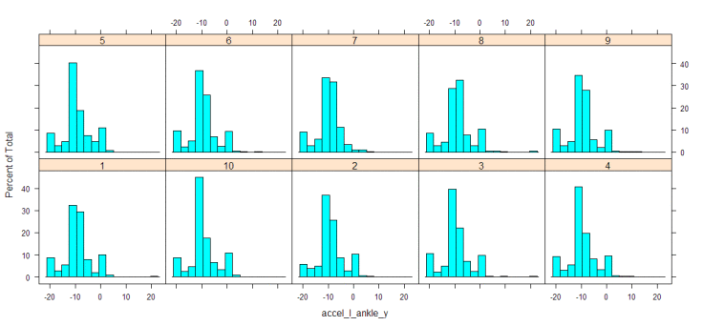
Exploration - Histograms
Histograms by activity and participant.
Important to tease out any imbalances in the data.

Slide 8
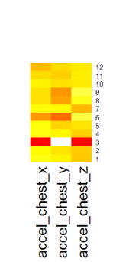
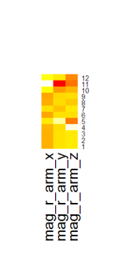
Exploration - Heatmaps
Quick way to isolate outliers and interesting features.
I used the mean across various break downs.
Notes:
Exercise 3 = lying down
Exercise 11 = running

Slide 9
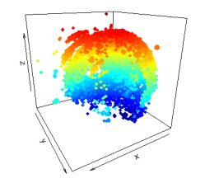
Exploration - Scatterplots
This data set consisted mostly of three-dimensional data.
Pretty cool to visualize and see some outliers.

Slide 10
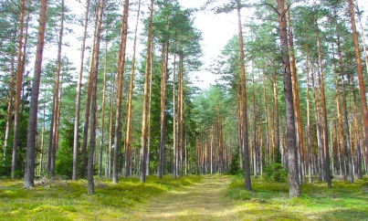
Random Forests
Arguably the most popular supervised machine learning method.
Require little tuning, if any.
Can be a little slow to generate, at least in R.
Using a sampled training set is often a must.
Notes:
https://upload.wikimedia.org/wikipedia/commons/7/77/Latvian_Forest_Tomes_pagasts%2C_%C4%B6eguma_novads%2C_Latvia.jpg

Slide 11
Random Forests – Model #1
Default parameters
Kappa = 0.9843
Very commonly the first model that data scientists will run.
Can be used as a baseline.

Slide 12
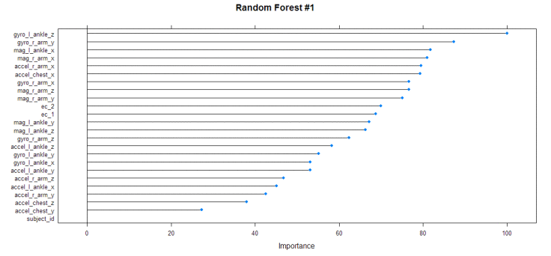
Random Forests – Model #1

Slide 13
Random Forests – Model #2
ntree = 1000
Kappa = 0.9852
Ran for about 20 minutes.
Didn’t really provide any major benefits over the default model.

Slide 14
Random Forests – Model #3
mtry = 10
Kappa = 0.9795
Not much difference.
Worst performing Random Forest model.

Slide 15
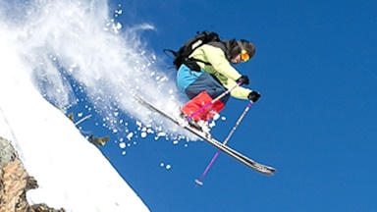
XGBoost
eXtreme Gradient Boosting
Relatively new to the community.
Came out in 2014
Similar to Random forests in that it relies on trees.
Different in that XGBoost uses boosting instead of bagging.
Models generate pretty quickly.
Had to adjust my response variable to be 0-indexed.
Notes:
https://i.ytimg.com/vi/6IrEDHx5hhw/maxresdefault.jpg

Slide 16
XGBoost – Model #1
Default parameters
Kappa = 0.8874
Not a bad first result, but certainly not as good out of the box as the default Random Forest model.

Slide 17
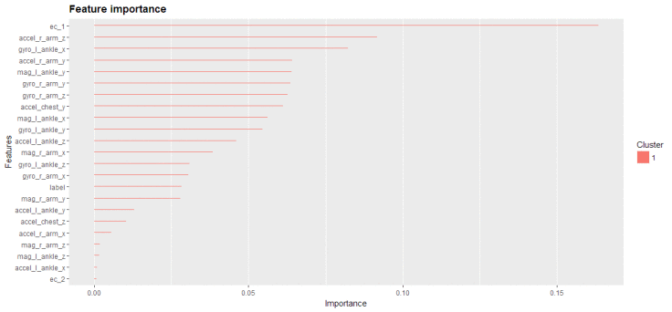
XGBoost – Model #1

Slide 18
XGBoost – Model #2
nrounds = 50
Kappa = 0.9803
Much better, the model is now boosting more.

Slide 19
XGBoost – Model #3
nrounds = 50
nfold = 5
Kappa = 0.9803
Same result as the second model.
Changing the number of subsamples didn’t have an effect.

Slide 20
XGBoost – Model #4
nrounds = 500
Kappa = 0.9838
Best XGBoost model generated but only by a little bit.

Slide 21
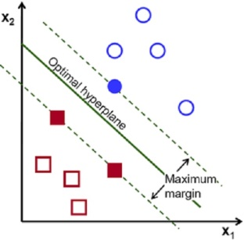
SVM
Support Vector Machines
Relies on fitting hyperplanes to classify data.
Famous for utilizing the kernel trick.
Generates models pretty quickly.
Tuning can be tedious.
Hyper-parameters are less intuitive than other methods.
More “mathematical” in nature.
Notes:
https://aitrends.com/wp-content/uploads/2018/01/1-19SVM-2.jpg

Slide 22
SVM – Model #1
Default parameters
Kappa = 0.9365
Middle of the pack in terms of out-of-the-box performance.
Not bad first attempt.
Notes:
Used radial kernel throughout each model; preliminary experimentation with other kernel methods yielded low Kappa values.

Slide 23
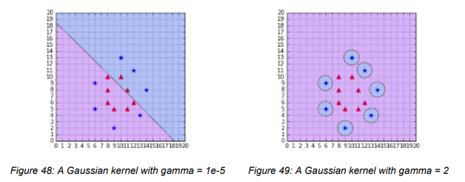
SVM – Model #2
gamma = 2
Kappa = 0.6402
Worst result out all the models.
Likely over-fitting.
Notes:
Book: SVM Succinctly by Alexandre Kowalczyk
https://www.svm-tutorial.com/2017/10/support-vector-machines-succinctly-released/
Default gamma = 1/(# of dimensions)

Slide 24
SVM – Model #3
gamma = 1/100
Kappa = 0.8633
Likely under-fitting.
Notes:
Default gamma = 1/(# of dimensions)

Slide 25
SVM – Model #4
C = 2
Kappa = 0.9491
Slight improvement over the default model.
Could do better..
Notes:
C = cost in R
Default C = 1

Slide 26
SVM – Model #5
C = 100
Kappa = 0.9744
Now competitive with the Random Forest and XGBoost models.

Slide 27
SVM – Model #6
C = 1000
Kappa = 0.9730
Not much difference in performance.

Slide 28
Comparison
Model | Notes | Kappa
Random Forest #1 | Default | 0.9843
Random Forest #2 | ntree=1000 | 0.9852
Random Forest #3 | mtry=10 | 0.9795
XGBoost #1 | Default | 0.8874
XGBoost #2 | nrounds=50 | 0.9803
XGBoost #3 | nrounds=50, nfold=5 | 0.9803
XGBoost #4 | nrounds=500 | 0.9838
SVM #1 | Default | 0.9365
SVM #2 | gamma=2 | 0.6402
SVM #3 | gamma=1/100 | 0.8633
SVM #4 | cost (C) = 2 | 0.9491
SVM #5 | cost (C) = 100 | 0.9744
SVM #6 | cost (C) = 1000 | 0.9730

Slide 29
Conclusion
Either of the three methods studied would suffice to predict physical exercises.
I would personally select XGBoost in practice.
Fast to generate.
Minimal tuning.
Intuitive.
SVM and Random Forests were okay but either slow to generate or counter-intuitive.
Biggest difficulties were dealing with some of the R syntax and understanding certain hyper-parameters.

